Slide 1

Lesson 8:
App architecture (UI layer)

Slide 2
About this lesson
Lesson 8: App architecture (UI layer)
Android app architecture
ViewModel
Data binding
LiveData
Transform LiveData
Summary

Slide 3
Android app architecture

Slide 4
Avoid short-term hacks
External factors, such as tight deadlines, can lead to poor decisions about app design and structure.
Decisions have consequences for future work (app can be harder to maintain long-term).
Need to balance on-time delivery and future maintenance burden.
Notes:
When you introduce short-term fixes into your app (instead of working against a plan and applying best practices), your app can start to accumulate technical debt. Technical debt is the cost of future rework accumulated by avoiding work that should have been done upfront. Technical debt can be caused by external factors like a deadline for a feature, a school assignment, or an emergency bug fix.
A series of fixes and patches may seem like an easy solution, and in rare cases it may be okay to choose the quick fix, but with projects that have multiple milestones, failing to consider design decisions as the scope of the project grows can hurt in the long run. Although some technical debt is unavoidable, the best strategy is to be aware of it and try to mitigate it by following best practices.

Slide 5
Examples of short-term hacks
Tailoring your app to a specific device
Blindly copying and pasting code into your files
Placing all business logic in activity file
Hardcoding user-facing strings in your code
Notes:
These examples of short-term decisions in Android can lead to technical debt, and make it harder for you to extend your app in a flexible and scalable way:
Tailoring your app to a specific device, rather than accounting for the many devices out there, will limit the audience your app can reach.
Copying and pasting third party code into your files without fully understanding it can lead to unanticipated conflicts and errors.
Putting all your business logic in the activity file can cause it to become overly large and unmanageable.
Hardcoding user-facing strings in your code would make localization of your app to other languages difficult.

Slide 6
Why you need good app architecture
Clearly defines where specific business logic belongs
Makes it easier for developers to collaborate
Makes your code easier to test
Lets you benefit from already-solved problems
Saves time and reduces technical debt as you extend your app
Notes:
The next few lectures will focus on app architecture. Good app architecture ensures that your app is scalable, reliable and easy to manage. When there is a clear structure defining where business logic belongs in your app, code is more understandable and it's easier for developers to collaborate and be consistent across modules.
Resource:
Guide to app architecture

Slide 7

Android Jetpack
Android libraries that incorporate best practices and provide backward compatibility in your apps
Jetpack comprises the androidx.* package libraries
https://developer.android.google.cn/jetpack
Notes:
To help you build apps that have good app architecture, we’ll be using Android Jetpack. You have actually already used Jetpack libraries when you used ConstraintLayout, RecyclerView, and other androidx.* package libraries.
Android Jetpack is a suite of libraries, tools, and instructional material that help you write high-quality apps more easily. These components help you follow best practices, free you from writing boilerplate code, and simplify complex tasks. The Jetpack guide to app architecture linked below is a useful read.
Resources:
Android Jetpack
Getting started with Android Jetpack
Explore the Jetpack libraries
Jetpack guide to app architecture

Slide 8
Android Jetpack
Jetpack is a suite of libraries to help developers follow best practices, reduce boilerplate code, and write code that works consistently across Android versions and devices so that developers can focus on the code they care about.
Watch Video: https://www.youtube.com/watch?v=LmkKFCfmnhQ
Notes:
To help you build apps that have good app architecture, we’ll be using Android Jetpack. You have actually already used Jetpack libraries when you used ConstraintLayout, RecyclerView, and other androidx.* package libraries.
Android Jetpack is a suite of libraries, tools, and instructional material that help you write high-quality apps more easily. These components help you follow best practices, free you from writing boilerplate code, and simplify complex tasks. The Jetpack guide to app architecture linked below is a useful read.
Resources:
Android Jetpack
Getting started with Android Jetpack
Explore the Jetpack libraries
Jetpack guide to app architecture

Slide 9
Separation of concerns
res/layout
UI Controller (Activity/Fragment)
ViewModel
LiveData
Data Layer
Notes:
The Jetpack "Guide to app architecture" talks about common architectural principles to follow. One of these is the separation of concerns. This graphic doesn’t show a specific design pattern to follow, but it does show a basic way to separate and isolate the places where things are done.
The activity or fragment is responsible for displaying data, and capturing user input and Android system events. It acts as a controller for the UI.
The ViewModel contains all the data needed to draw the UI, and the functions that keep it up to date. Later in the lesson, we’ll talk more about how LiveData can help you keep UIs up to date.
In later lectures, we’ll discuss the specific components that control how we provide data to the ViewModel.
Resources:
Guide to app architecture
Separation of concerns

Slide 10
Architecture components
Architecture design patterns, like MVP, MVVM and MVI, describe a loose template for what the structure of your app should be.
Jetpack architecture components help you design robust, testable, and maintainable apps.
Notes:
You may have heard of architecture design patterns like MVVM (Model-View-ViewModel), or MVI (Model-View-Interactor), and others. These design patterns offer general guidance on what your app should look like. The architecture components in the Jetpack libraries give you specific tools to implement those design patterns. In this lesson we'll focus on these architecture components.
Resource:
Android Architecture Components

Slide 11
Evolution of Android Architectures
Imagine a world where every developer codes the way he feels like — with no guidelines, principles or rules.
The end result would be a code that would be difficult to comprehend, probably buggy & definitely a nightmare to maintain.
Notes:
You may have heard of architecture design patterns like MVVM (Model-View-ViewModel), or MVI (Model-View-Interactor), and others. These design patterns offer general guidance on what your app should look like. The architecture components in the Jetpack libraries give you specific tools to implement those design patterns. In this lesson we'll focus on these architecture components.
Resource:
Android Architecture Components

Slide 12

The Beginner: MVP
Model View Presenter (MVP) was one of the first few mainstream architecture adopted by the Android community.
Notes:
You may have heard of architecture design patterns like MVVM (Model-View-ViewModel), or MVI (Model-View-Interactor), and others. These design patterns offer general guidance on what your app should look like. The architecture components in the Jetpack libraries give you specific tools to implement those design patterns. In this lesson we'll focus on these architecture components.
Resource:
Android Architecture Components

Slide 13
The Beginner: MVP
Components in MVP
Model: Source of data. Comprises of repositories & services.
View: The UI layer.
Presenter: Handles presentational logic. Interacts with model & updates view.
Notes:
You may have heard of architecture design patterns like MVVM (Model-View-ViewModel), or MVI (Model-View-Interactor), and others. These design patterns offer general guidance on what your app should look like. The architecture components in the Jetpack libraries give you specific tools to implement those design patterns. In this lesson we'll focus on these architecture components.
Resource:
Android Architecture Components

Slide 14

The Reactive: MVVM
The core idea behind MVVM (Model-View-ViewModel) is that the current state of the views is represented by a model.
Notes:
You may have heard of architecture design patterns like MVVM (Model-View-ViewModel), or MVI (Model-View-Interactor), and others. These design patterns offer general guidance on what your app should look like. The architecture components in the Jetpack libraries give you specific tools to implement those design patterns. In this lesson we'll focus on these architecture components.
Resource:
Android Architecture Components

Slide 15
The Reactive: MVVM
Components
Model: Source of data. Comprises of repositories & services.
View: UI layer. Subscribes to ViewModel
ViewModel: Holds current state of the view, and notifies subscribers whenever it is updated.
Notes:
You may have heard of architecture design patterns like MVVM (Model-View-ViewModel), or MVI (Model-View-Interactor), and others. These design patterns offer general guidance on what your app should look like. The architecture components in the Jetpack libraries give you specific tools to implement those design patterns. In this lesson we'll focus on these architecture components.
Resource:
Android Architecture Components

Slide 16
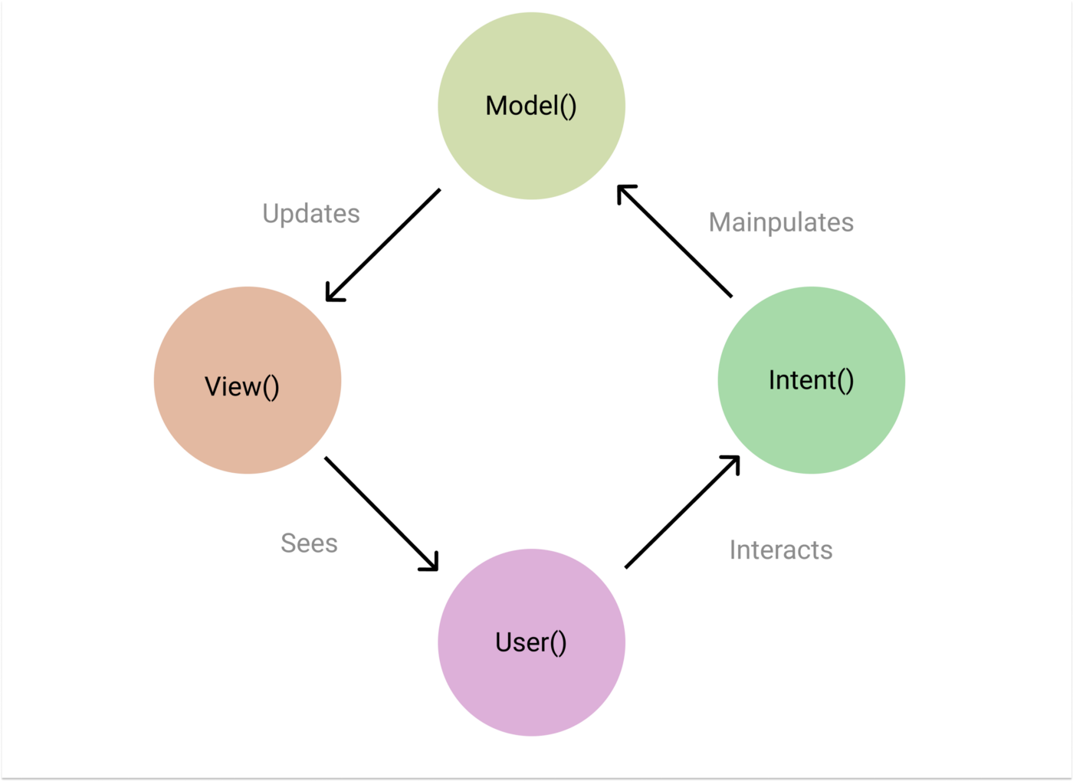
The Advanced: MVI
In general, if we see Model-View-Intent (MVI) from a mathematical point of view(f:X→Y), We have inputs ‘X’ and we perform some function ‘f:’ to it and give back outputs ‘Y’.
Notes:
You may have heard of architecture design patterns like MVVM (Model-View-ViewModel), or MVI (Model-View-Interactor), and others. These design patterns offer general guidance on what your app should look like. The architecture components in the Jetpack libraries give you specific tools to implement those design patterns. In this lesson we'll focus on these architecture components.
Resource:
Android Architecture Components

Slide 17
ViewModel
Notes:
In the earlier diagram, you may have noticed the ViewModel class, which is part of Android Architecture Components. Let’s discuss why we need this class.
The Android framework manages the lifecycles of UI controllers, such as activities and fragments. The framework may decide to destroy or re-create a UI controller in response to user actions or system events that are beyond your control. If the system does destroy or re-create a UI controller, any transient data stored in them is lost.
Because these UI controllers are primarily responsible for displaying information to the user and handling user input events, we don’t want to add the additional responsibility of handling data to them as well. Therefore, we need a separate entity to manage the data, which is a ViewModel.
Resource:
Android Architecture Components

Slide 18
Gradle: lifecycle extensions
In app/build.gradle file:
dependencies {
implementation "androidx.lifecycle:lifecycle-viewmodel-ktx:$lifecycle_version"
implementation "androidx.activity:activity-ktx:$activity_version"
}
Notes:
To enable ViewModel in our apps, we need to add some dependencies to our module’s Gradle file.
See the instructions for declaring dependencies in the Lifecycle release notes and Activity release notes.

Slide 19
ViewModel
Prepares data for the UI
Must not reference activity, fragment, or views in view hierarchy
Scoped to a lifecycle (which activity and fragment have)
Enables data to survive configuration changes
Survives as long as the scope is alive
Notes:
The ViewModel is the model that prepares and manages the data for the UI, and the Activity or Fragment displays the data from the ViewModel. However, the ViewModel should not hold direct references to views in the view hierarchy, or references to the Activity or Fragment itself. This separates out ownership of the data from UI controller logic.
ViewModel objects are scoped to a Lifecycle (activities and fragments have Lifecycles). ViewModel objects are automatically retained during configuration changes so that data they hold is immediately available to the next activity or fragment instance. The ViewModel remains in memory until the Lifecycle it's scoped to goes away permanently.
Resources:
ViewModel Overview
ViewModel
ViewModels: A Simple Example (note: example is in Java)

Slide 20
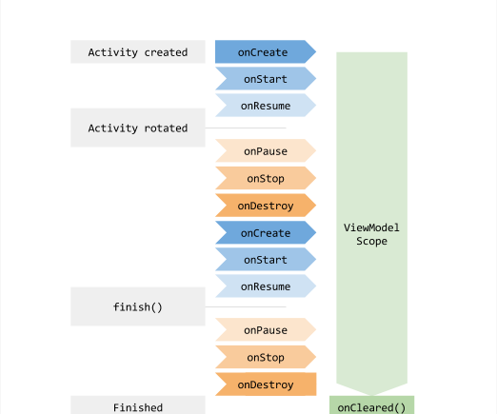
Lifetime of a ViewModel
Notes:
This diagram shows the lifetime for a ViewModel alongside its associated activity, as it goes through its various lifecycle changes. The ViewModel sticks around even during a configuration change (when the activity is destroyed and re-created).
Note that we don’t have to manually save and restore the state from a Bundle anymore because we can retrieve the same ViewModel instance after a configuration change and set up the UI again. The ViewModel remains in memory until the activity is finished, and then the ViewModel onCleared() method is called to clean up resources.
Resource:
The lifecycle of a ViewModel

Slide 21
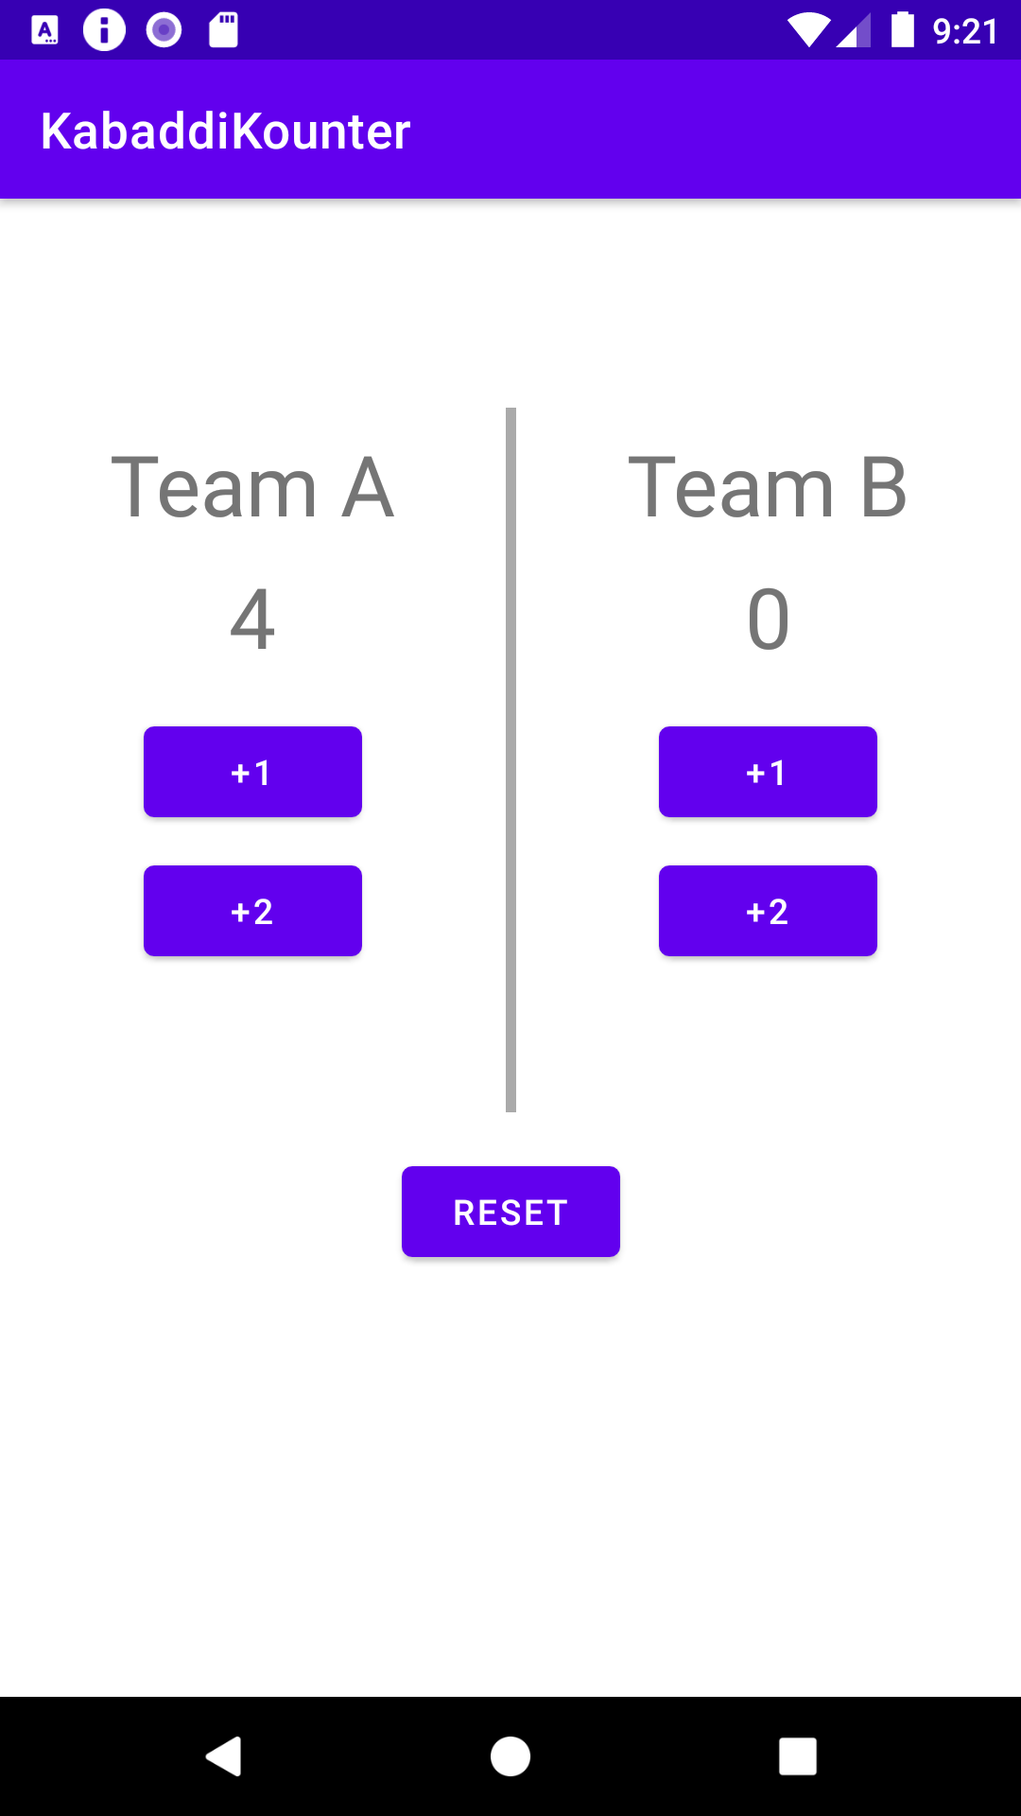
Kabaddi Kounter
Notes:
To see how a ViewModel is used in an app, let’s look at some of the steps needed to make a scorekeeper app for Kabaddi, a contact sport popular in South Asia. In Kabaddi, there are two teams of seven players each with points awarded in increments of +1 or +2 to one team or the other.

Slide 22
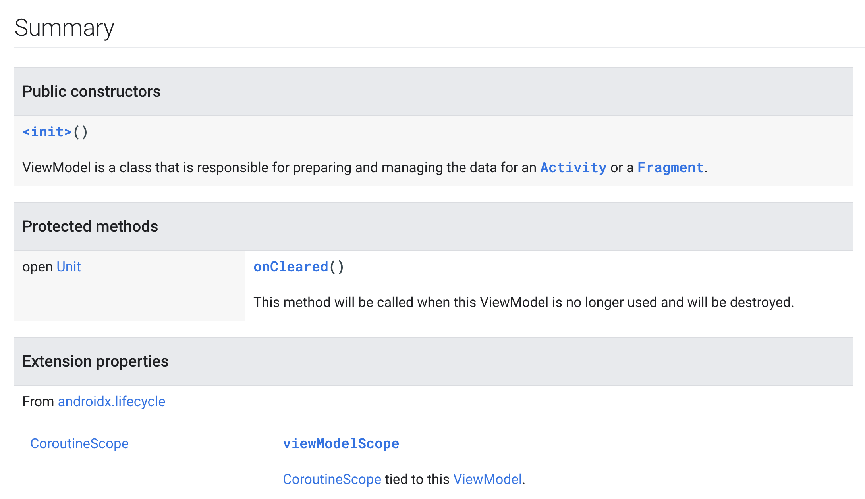
ViewModel class
abstract class ViewModel
Notes:
Before we look at the code for creating a ViewModel, please note that ViewModel is an abstract class in Kotlin. If you remember from the earlier Kotlin lessons, an abstract class cannot be instantiated, it must be subclassed. It has the protected onCleared() method, which is called when the ViewModel is no longer used and will be destroyed.
Resource:
ViewModel

Slide 23
Implement a ViewModel
class ScoreViewModel : ViewModel() {
var scoreA : Int = 0
var scoreB : Int = 0
fun incrementScore(isTeamA: Boolean) {
if (isTeamA) {
scoreA++
}
else {
scoreB++
}
}
}
Notes:
To create a ViewModel for the KabaddiKounter app, first create a ScoreViewModel class that extends the abstract ViewModel class. ScoreViewModel stores two integer scores, one for team A and one for team B.

Slide 24
Load and use a ViewModel
class MainActivity : AppCompatActivity() {
// Delegate provided by androidx.activity.viewModels
val viewModel: ScoreViewModel by viewModels()
override fun onCreate(savedInstanceState: Bundle?) {
...
val scoreViewA: TextView = findViewById(R.id.scoreA)
scoreViewA.text = viewModel.scoreA.toString()
}
Notes:
Within the MainActivity, use the by viewModels() Kotlin property delegate from the activity-ktx artifact to get the ScoreViewModel.
Resources:
viewModels extension function
Delegated properties
Android KTX

Slide 25
Using a ViewModel
Within MainActivity onCreate():
val scoreViewA: TextView = findViewById(R.id.scoreA)
val plusOneButtonA: Button = findViewById(R.id.plusOne_teamA)
plusOneButtonA.setOnClickListener {
viewModel.incrementScore(true)
scoreViewA.text = viewModel.scoreA.toString()
}
Notes:
We add a click listener on the +1 button for team A, which increments the score by calling the ViewModel. Then we update the TextView with the new score. We’ll fix this later so we don’t have to manually keep updating the TextVIew.

Slide 26
Data binding

Slide 27
ViewModels and data binding
App architecture without data binding
ViewModel
UI Controller
(activity/fragment with click listeners)
Views
(defined in XML layout)
ViewModels can work in concert with data binding
ViewModel
Views
(defined in XML layout)
Notes:
Transition: 1 click
ViewModel objects hold the data in your app. In the layout, it would be simpler if the ViewModel instance communicated directly with the views, without relying on UI controllers as intermediaries.
By passing ViewModel objects into the data binding, you can automate some of the communication between the views and the ViewModel objects.

Slide 28
Data binding in XML revisited
Specify ViewModels in the data tag of a binding.
<layout>
<data>
<variable>
name="viewModel"
type="com.example.kabaddikounter.ScoreViewModel" />
</data>
<ConstraintLayout ../>
</layout>
Notes:
We can use a ViewModel in our layout XML just like any other object. It’s important to note that this declaration doesn’t automatically bind a ViewModel. It just declares that there will be a ScoreViewModel exposed to this binding.

Slide 29
Attaching a ViewModel to a data binding
class MainActivity : AppCompatActivity() {
val viewModel: ScoreViewModel by viewModels()
override fun onCreate(savedInstanceState: Bundle?) {
super.onCreate(savedInstanceState)
val binding: ActivityMainBinding = DataBindingUtil.setContentView(this,
R.layout.activity_main)
binding.viewModel = viewModel
...
Notes:
Here is where we actually attach a ViewModel to our binding.

Slide 30
Using a ViewModel from a data binding
In activity_main.xml:
<TextView
android:id="@+id/scoreViewA"
android:text="@{viewModel.scoreA.toString()}" />
...
Notes:
With the binding step done, we can use that ViewModel in a data binding expression in the XML layout. When the view is first inflated, this TextView will properly reflect the score of Team A.

Slide 31
ViewModels and data binding
override fun onCreate(savedInstanceState: Bundle?) {
...
val binding: ActivityMainBinding = DataBindingUtil.setContentView(this,
R.layout.activity_main)
binding.plusOneButtonA.setOnClickListener {
viewModel.incrementScore(true)
binding.scoreViewA.text = viewModel.scoreA.toString()
}
}
Notes:
When the button is clicked, we still need to update the TextView because the android:text attribute of the TextView is only set when the view is instantiated. It doesn’t update when the ViewModel changes. We’ll tackle that problem next.

Slide 32
LiveData

Slide 33
Observer design pattern
Subject maintains list of observers to notify when state changes.
Observers receive state changes from subject and execute appropriate code.
Observers can be added or removed at any time.
Notes:
The observer design pattern is where an object (subject or observable) maintains a list of dependent objects (observers) to notify when there are state changes in the subject.
Data binding has reduced some of the assignments and function calls in our UIs. However, we still need to explicitly update views with the new ViewModel values when they change. There is a better way.

Slide 34
Observer design pattern diagram
Observable
notify
observe()
notify
observe()
Observer
Observer
Notes:
The observer design pattern specifies communication between an observable (the "subject" of observation) and observers. An observable notifies observers about changes in its state.

Slide 35
LiveData
A lifecycle-aware data holder that can be observed
Wrapper that can be used with any data including lists (for example, LiveData<Int> holds an Int)
Often used by ViewModels to hold individual data fields
Observers (activity or fragment) can be added or removed
observe(owner: LifecycleOwner, observer: Observer)
removeObserver(observer: Observer)
Notes:
In our app, we’re going to use LiveData, which is a lifecycle-aware data holder that can be observed. It’s essentially a wrapper around any type of data. For example, LiveData<Int> holds an Int. Because we have LiveData as a wrapper around the data, we can now observe changes on that data.
According to the observer pattern we just spoke about, the observable is the LiveData, and observers can be added to listen for changes on the data. The observers would be UI Controllers, like Activity or Fragment, that want to know when the underlying data changes so they can update the UI. The LiveData classes are crucial in communicating from the ViewModel to the fragment or activity.
Looking at the method signature, note that an Observer is added in conjunction with a LifecycleOwner and the Observer only receives updates when LifeCycleOwner is in active state.

Slide 36
LiveData versus MutableLiveData
LiveData<T> | MutableLiveData<T>
getValue() | getValue() postValue(value: T) setValue(value: T)
T is the type of data that’s stored in LiveData or MutableLiveData.
Notes:
LiveData has no public methods to update the stored data. You can think of it as "read-only." On the other hand, the MutableLiveData class exposes the public methods setValue(T) and postValue(T). You will commonly see MutableLiveData used as a private variable in the ViewModel, and then the ViewModel only exposes an immutable LiveData object to the observers. This enforces the separation of concerns, as the ViewModel is the one responsible for implementing any logic and updating the MutableLiveData, while the role of the UI is just to react to LiveData value changes.
Resource:
LiveData
MutableLiveData
Generics in Kotlin

Slide 37
Use LiveData in ViewModel
class ScoreViewModel : ViewModel() {
private val _scoreA = MutableLiveData<Int>(0)
val scoreA: LiveData<Int>
get() = _scoreA
fun incrementScore(isTeamA: Boolean) {
if (isTeamA) {
_scoreA.value = _scoreA.value!! + 1
}
...
Notes:
Here, we’ve updated our ViewModel code to use LiveData. We don’t want any external object or observable to change our scores, so we have a private MutableLiveData and a public LiveData that can’t be reassigned. Note that _scoreA is initialized to a MutableLiveData that holds an Int of 0. When it’s time to increment the score, we only modify _scoreA. If any outside caller tries to access the public scoreA property, the class actually returns _scoreA as an immutable LiveData.
Resources:
MutableLiveData Constructor
Getters and Setters in Kotlin

Slide 38
Add an observer on LiveData
Set up click listener to increment ViewModel score:
binding.plusOneButtonA.setOnClickListener {
viewModel.incrementScore(true)
}
Create observer to update team A score on screen:
val scoreA_Observer = Observer<Int> { newValue ->
binding.scoreViewA.text = newValue.toString()
}
Add the observer onto scoreA LiveData in ViewModel:
viewModel.scoreA.observe(this, scoreA_Observer)
Notes:
Transitions: 2 clicks
Now that we have that setup done, we can set up an observer to monitor scoreA and update the corresponding TextView onscreen every time the user clicks the +1 button. Note that we can use the SAM version of the Observer interface (onChanged(t: T) converted to SAM).
Resource:
Observer

Slide 39
Two-way data binding
We already have two-way binding with ViewModel and LiveData.
Binding to LiveData in XML eliminates need for an observer in code.
Notes:
The next few slides show the final state of the code with LiveData wired up. We were able to greatly reduce the amount of code we had to write to keep our UI in sync.

Slide 40
Example layout XML
<layout>
<data>
<variable>
name="viewModel"
type="com.example.kabaddikounter.ScoreViewModel" />
</data>
<ConstraintLayout ..>
<TextView ...
android:id="@+id/scoreViewA"
android:text="@{viewModel.scoreA.toString()}" />
...
</ConstraintLayout>
</layout>
Notes:
We assign the TextView text attribute using the ViewModel variable. This will remove the need for an observer for LiveData.

Slide 41
Example Activity
class MainActivity : AppCompatActivity() {
val viewModel: ScoreViewModel by viewModels()
override fun onCreate(savedInstanceState: Bundle?) {
super.onCreate(savedInstanceState)
val binding: ActivityMainBinding = DataBindingUtil .setContentView(this, R.layout.activity_main)
binding.viewModel = viewModel
binding.lifecycleOwner = this
binding.plusOneButtonA.setOnClickListener {
viewModel.incrementScore(true)
}
...
Notes:
Set our viewModel on the binding object. Specify the current activity as the lifecycleOwner.
Note that we no longer require the observer object. We no longer need to update the score TextView manually when the +1 button is clicked.

Slide 42
Example ViewModel
class ScoreViewModel : ViewModel() {
private val _scoreA = MutableLiveData<Int>(0)
val scoreA : LiveData<Int>
get() = _scoreA
private val _scoreB = MutableLiveData<Int>(0)
val scoreB : LiveData<Int>
get() = _scoreB
fun incrementScore(isTeamA: Boolean) {
if (isTeamA) {
_scoreA.value = _scoreA.value!! + 1
} else {
_scoreB.value = _scoreB.value!! + 1
}
}
}
Notes:
Now any changes made to team A or team B’s scores will automatically update the TextViews in the layout. Whenever incrementScore() is called, the changes are reflected in the UI.

Slide 43
Transform LiveData
Notes:
Before we end, let’s talk about one more way you can use LiveData. You may want to make changes to the value stored in a LiveData object before dispatching it to the observers. Or you may need to return a different LiveData instance based on the value of another one. The Lifecycle package provides the Transformations class which has helper methods for these scenarios.

Slide 44
Manipulating LiveData with transformations
LiveData can be transformed into a new LiveData object.
map()
switchMap()
Notes:
We can use Transformation methods to perform data manipulations on the source LiveData and return a result LiveData object. These transformations aren't calculated unless an observer is observing the returned LiveData object.
These methods take as parameters: the source LiveData and a function which manipulates the source LiveData.
Resources:
Transform LiveData
Transformations

Slide 45
Example LiveData with transformations
val result: LiveData<String> = Transformations.map(viewModel.scoreA) {
x -> if (x > 10) "A Wins" else ""
}
Notes:
In this snippet, let’s assume a game ends when one team gets to 10 points. This map observes scoreA in the ViewModel and constructs a LiveData that holds a String. This LiveData instance can in turn be observed and trigger a change in the UI.

Slide 46
Summary

Slide 47
Summary
In Lesson 8, you learned how to:
Follow good app architecture design, and the separation-of-concerns principle to make apps more maintainable and reduce technical debt
Create a ViewModel to hold data separately from a UI controller
Use ViewModel with data binding to make a responsive UI with less code
Use observers to automatically get updates from LiveData

Slide 48
Learn More
Guide to app architecture
Android Jetpack
ViewModel Overview
Android architecture sample app
ViewModelProvider
Lifecycle Aware Data Loading with Architecture Components
ViewModels and LiveData: Patterns + AntiPatterns

Slide 49

Pathway
Practice what you’ve learned by completing the pathway:
Lesson 8: App architecture (UI layer)

